Slide 1




Data Communication Concepts
Domain Name System (DNS)
Lab 8

Slide 2
Outline
Outline
Overview
Domain Name System (DNS)
DNS implemented in Packet Tracer Simulation

Slide 3
Overview
Outline
In this lab, we will learn about Domain Name System and how we can implemented and simulated it in packet tracer.

Slide 4
Domain Name System (DNS)
Outline
To identify an entity, TCP/IP protocols use the IP address, which uniquely identifies the connection of a host to the Internet. However, people prefer to use names instead of numeric addresses. Therefore, we need a system that can map a name to an address or an address to a name.
The following figure shows how TCP/IP uses a DNS client and a DNS server to map a name to an address.

Slide 5
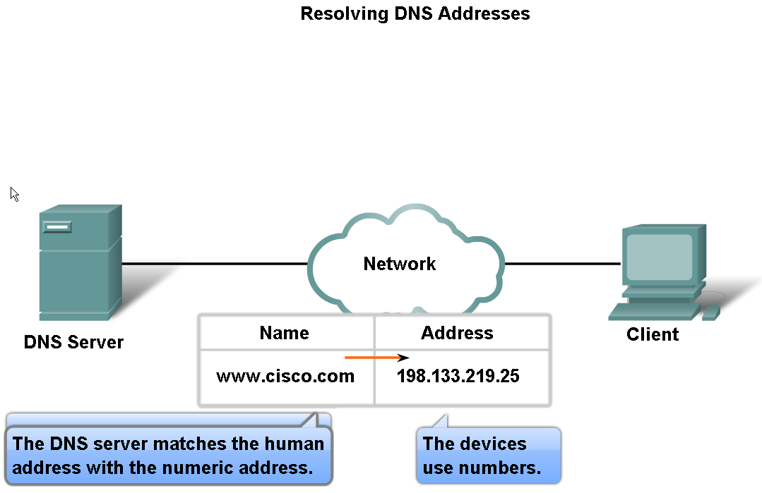
Domain Name System (DNS)
Outline

Slide 6
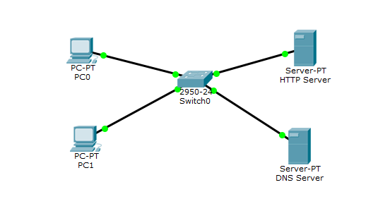
Outline
Implementation of DNS in Packet Tracer Simulation
The following network diagram example show the concept of DNS, in this example the client want to display the default page of packet tracer website:

Slide 7
Outline
Implementation of DNS in Packet Tracer Simulation
1. Give an IP address for each device as follows:
Device | IP address | IP of DNS server
PC0 | 10.0.0.3/24 | 10.0.0.2
PC1 | 10.0.0.4/24 | 10.0.0.2
HTTP Server | 10.0.0.1/24 | 10.0.0.2
DNS Server | 10.0.0.2/24 | -

Slide 8
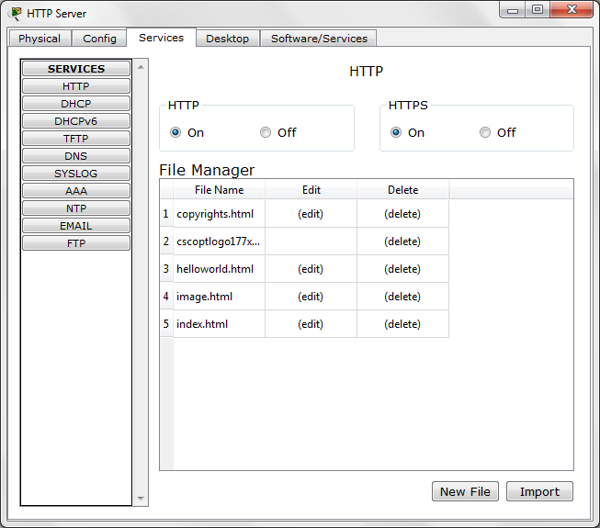
Outline
Implementation of DNS in Packet Tracer Simulation
2. Set the HTTP service in HTTP server

Slide 9
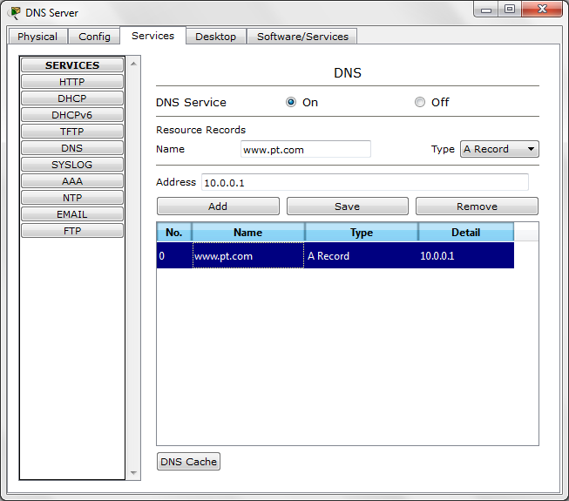
Outline
Implementation of DNS in Packet Tracer Simulation
3. Set the DNS service in DNS server and enter the following configuration information.
1
2
3
4

Slide 10
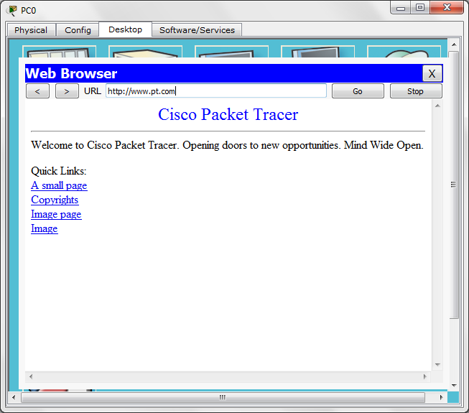
Outline
Implementation of DNS in Packet Tracer Simulation
4. Open the web browser in PC0 and write www.pt.com in the URL and see that the home page of the website will open.

Slide 11


THANK YOU

